Slide 1

TTS Video Creation: An Introduction
Together, we can easily create fantastic videos
January, 2024

Slide 2

Video Template Introduction - Agenda
Introduction
PowerPoint Templates - Adaptations
Avatars
View Modes
Characters
Language Options
Preparation & Production
Conclusions

Slide 3
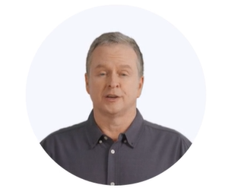

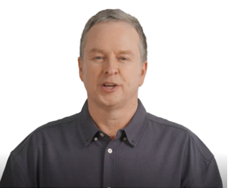
PowerPoint Templates - Adaptations
Video Backgrounds
Avatar: Characters – Edward, Brianna, Jeff and Monica
Avatar: View Options
Close Up Circle
Half Body
P.S. Don’t forget to leave space at the bottom of the slide for the captions

Slide 4
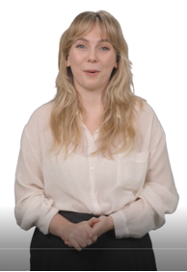
Brianna: Half-Body view in her White Blouse

Slide 5

Jeff: Half-Body view in Sweater

Slide 6
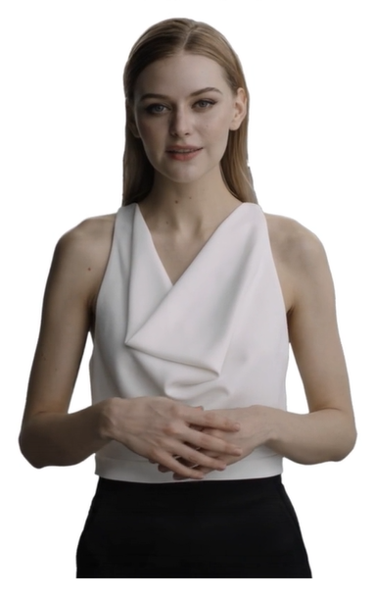
Monica: Half-Body view in Sleeveless

Slide 7
Avatars: Language Options
48 Languages:
Arabic Bangla Bulgarian Catalan
Chinese Croatian Czech Danish
Dutch English Estonian Filipino
Finnish French Georgian German
Greek Gujurati Hebrew Hindi
Hungarian Indonesian Italian Japanese
Kannada Kiswahili Korean Latvian
Lithuanian Malay Marathi Nepali
Norwegian Persian Polish Portuguese
Romanian Russian Serbian Sinhala
Slovak Spanish Swedish Tamil
Telegu Thai Turkish Ukrainian
Flexible – more than one language can be used in a video

Slide 8
Video Production: Preparation & Generation
To make a TTS Video, it is necessary to:
Create a PowerPoint Presentation
Write the audio text for each slide in a Word document
Choose the avatars to be used for each slide
We will then:
Generate video
Send it to you for reviewing.
That’s all!

Slide 9
Thanks for watching TTS’s:
TTS Video Creation: An Introduction
Together, we can easily create fantastic videos
Visit us at: https://www.tradetech.cloud or email us: videos@tradetech.cloud

